Slide 1
Course : Computational Biology
Effective Period : June 2022
Working with
Biological Database Session 5.1

Slide 2
Objective and Outline
LO : Execute a planned simulation of Introduction to BioPython, DNA Sequence Analysis, and DNA Sequence Alignment
In this course we will be simulating basic Bioinformatics analysis using Biopython. Although the Python part is dominant, this course is still ideal for students only with a basic knowledge of biology. The course contains a basic introduction to the Jupyter Notebook and Colab Environment,
In this session, we will start exploring a simulation concept using Open-Source Biopython
Official Website : https://biopython.org/
Outline
Preparing a Genomic Research (OPTIONAL)
Inquiry and Exporting Genomic Data from NDBI

Slide 3
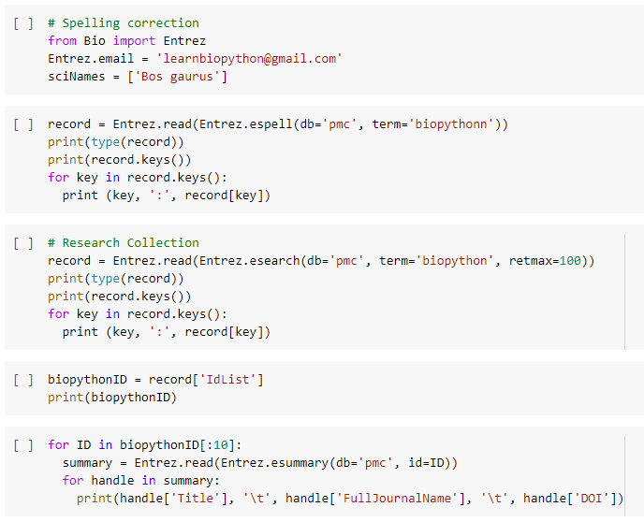
Spelling and Research Collection
To prepare a research in Bioinformatics, a systematic literature study is very important. This two

Slide 4
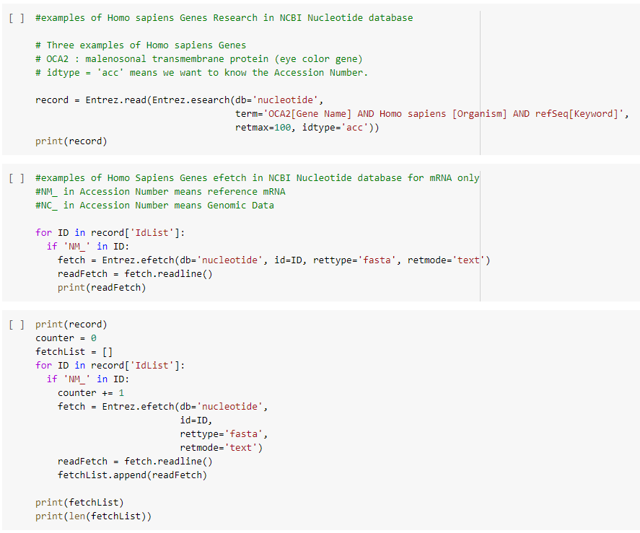
Inquiry and Exporting Genomic Data from NCBI
This part elaborate the practical method to inquiry a human specific protein of HBB (hemoglobin subunit beta) in NCBI Nucleotide database
At the end of the part, we export the dataset into a .FASTA file that we could use for another analysis

Slide 5
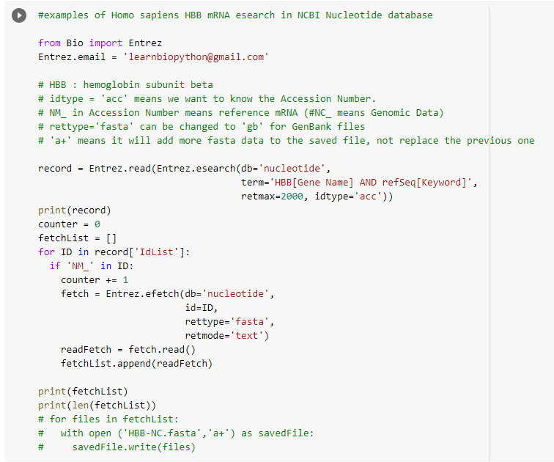
Inquiry and Exporting Genomic Data from NCBI
This part elaborate the practical method to inquiry a human specific protein of HBB (hemoglobin subunit beta) in NCBI Nucleotide database
At the end of the part, we export the dataset into a .FASTA file that we could use for another analysis

Slide 6
Exercise
Try to inquiry other dataset, such as OCA2 : malenosonal transmembrane protein (eye color gene)
Change term='OCA2[Gene Name] AND
Homo sapiens [Organism] AND refSeq[Keyword]'

Slide 7
Course : Computational Biology
Effective Period : June 2022
Working with Common File Formats Session 5.2

Slide 8
Objective and Outline
LO : Execute a planned simulation of Introduction to BioPython, DNA Sequence Analysis, and DNA Sequence Alignment
In this course we will be simulating basic Bioinformatics analysis using Biopython. Although the Python part is dominant, this course is still ideal for students only with a basic knowledge of biology. The course contains a basic introduction to the Jupyter Notebook and Colab Environment,
In this session, we will start exploring a simulation concept using Open-Source Biopython
Official Website : https://biopython.org/
Outline
Working with FASTA files
Working with PDB files
Protein Explanatory Data Analysis

Slide 9
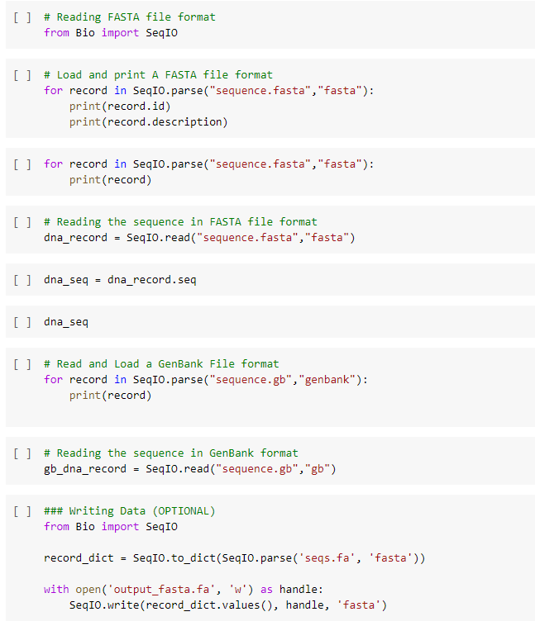
Working with Common File Formats

Slide 10
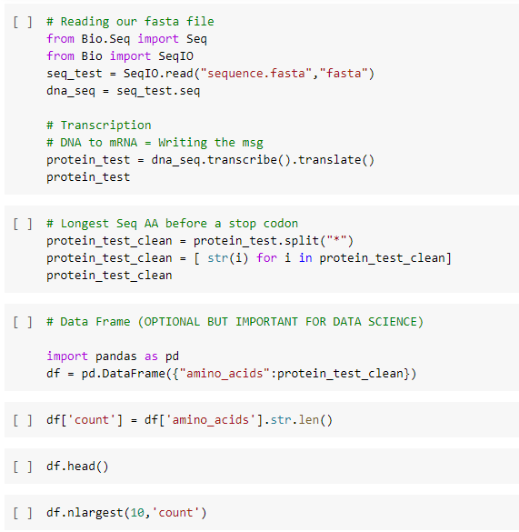
Protein Explanatory Data Analysis
This in a summary and practical example from what we have done in the previous part
1. Read a .fasta DNA sequence file
2. do Transcriptiaon and Translation
3. do basic Explanatory Data Analysis

Slide 11
Exercise
Do the same exercise of Protein EDA using the FASTA file you have previously export

